Slide 1
ISD: Introduction Software Developtment
Tu Phung: Taking note.

Slide 2
ISD INTRODUCTION SOFTWARE DEVELOPTMENT
Content:
HTML
CSS
Java
…

Slide 3
HTML
HTML is the standard markup language for Web pages.
With HTML you can create your own Website.
We need to know the format and syntax.

Slide 4
Format HTML
<!DOCTYPE html>
<html lang="en">
<head>
<link ref="stylesheet" href=“file.css"> ➔ link to file CSS.
<title> Titles </title> ➔ the Titles show on the TAB
</head>
<body>
<img class=“Name" src=“picture" alt=“word describe"> ➔ add the image with class “Name”
<a href=“file.html"> Word/Image showed</a> ➔ use for link to another html file
<h1> </h1> ➔ default heading (from h1…h6)
<ul> ➔ under list make the list, same with <ol> ‘order list’
<h2> <li> </li> </h2> ➔ symbol for every rows.
</ul>
<section class=“Name1”> ➔ define the section for using different class
<p> ➔ paragraph default
<br> ➔ break the row.
</p>
</section>
</body>
</html>

Slide 5
CSS: describes how HTML elements should be displayed.
abc {
color: ...; background-color: ...; font-family: ...; font-size: ...px; width: ...px; height: ...px; text-align: ...; text-emphasis: ...; text-decoration: ...; border-radius: ...px; margin: ...px; margin-top: ...px; ...We can choose the which one be suitable for the format
}
abc ➔ can be body/ header/ h1/ h2/ h3/ p/
.Name ➔ .Name is we defined as class in html file (don’t forget period)
#ID => with hashtag.

Slide 6

Algorithms
Homepage
(HTML CSS)
Page 1 (HTML CSS)
Page 2 (HTML CSS)
Page 3 (HTML CSS)
Page 4 (HTML CSS)
…….
LINK
We can link between page to other page by <a ….>

Slide 7
Java
Variable
(var ⬄ let)
If else
Loop (for, while, do while)
Function declare
Function Constructor
let a = 0; -> integer
let b = 3.003; -> double
const c = 3.14; -> constant
let s = “string”;->string
let array d =[1,2,3];
const array e = [1,2,3];
*When array declare as const, we can’t assign the new value for array “e” => can’t do e = [4,5,6];
If(condition 1){
operarting 1;
} else if (condition 2){
operarting 2;
}else{
operarting 3;
}
for (let i =0; i<length; i++){
operating;
}
do {} while(condition);
Use for checking input before continue.
while(condition){}
function product (a,b){
return a*b;
}
const product =
new Function('a', 'b', 'return a * b’);

Slide 8
Popular Command
console.log(“sentence” + variable);=> print into console window.
Math.floor(numb).toFixed(2); =>round down and take 2 digits after colon.
Math.ceil(numb); => round up.
Math.round(numb); => round to the nearest integer number.
Math.random(numb); => random from 0 to 1;
alert('Please enter numeric values only’); =>alert when match condition.
!isNaN(numb);=>check input/variable is number or not.
Number.isInteger(numb);=> check numb is Integer. - Number.isFloat(numb);
parstFloat(numb); => transform input to Float - parstInt(numb);
document.write("<table>");//showing the table in HTML format – “<br>…”
var Action = prompt(“Are you human?");=>show input window on the screen
var lowerAction = Action.toLowerCase();=>transform lowercase the input – toUpperCase()
window.onload = todo;=>call function todo when the page is load fully.
console.log(`”After” ${i} week ${original.toFixed(1)} kg<br>`);=>take value into backtip
console.log(“\”After\”” + i + “week” + original.toFixed(1) + “kg<br>”);=> normal way.
element = words.charAt(i); => take the letter at i position of string words

Slide 9
Popular Command
let encoded = window.btoa("Hello World!");// transform to encodes a string in base-64. let decoded = window.atob(encoded);//method decodes a base-64 encoded string.
const myWin = window.open("", "", "left=100, top=350, width=500, height=900");}
myWin.blur();// allowing other windows or elements to become active.
myWin.focus();// the active window in the browser
<button onclick="openWin()">Open "myWindow"</button>
<button onclick="closeWin()">Close "myWindow"</button>
let myWindow;function openWin() {myWindow = window.open("", "", "width=200,height=100");}
function closeWin() {myWindow.close();}
function myFunction() { let text = "Press a button!\nEither OK or Cancel.";
if (confirm(text) == true) {text = "You pressed OK!";} else {text = "You canceled!";}
document.getElementById("demo").innerHTML = text;}
let url = window.document.URL;//get the current url. - let url = document.URL;
localStorage.setItem(key, value);//Save Data to local Storage.
let lastname = localStorage.getItem(key);//Read Data from local Storage.
localStorage.removeItem(key);//Remove key only - localStorage.clear(); //Remove all

Slide 10
Apply for count the click or summarize visiting.
<p><button onclick="clickCounter()" type="button">Click me!</button></p>
<p>Number of clicks:</p> <p id="demo"></p>
clickCounter();
function clickCounter() {
if (localStorage.clickcount) {
localStorage.clickcount = Number(localStorage.clickcount)+1;
} else {localStorage.clickcount = 1;}
document.getElementById("demo").innerHTML = localStorage.clickcount;}
pageVisitCounter();// Call pageVisitCounter function when the page loads
function pageVisitCounter() { // Check if localStorage contains visitCount
if (localStorage.visitCount) { // Increment visitCount if it exists
localStorage.visitCount = Number(localStorage.visitCount) + 1; } else {localStorage.visitCount = 1; }
document.getElementById("visitCount").innerHTML = localStorage.visitCount; } //Display.
<button onclick="myFunction()">Load new document</button> //load to the new page.
function myFunction() {location.assign(“www./TuPhung/");}//add history.
location.reload() //reload the current document.
function myFunction() {location.replace("https://www.w3schools.com");}//don’t add history

Slide 11
Move the window.
<button onclick="openWin()">Open "myWindow"</button>
<button onclick="moveWin()">Move "myWindow"</button>
let myWin;
function openWin(){myWin = window.open("", "", "width=400, height=400");}
function moveWin(){myWin.moveBy(250, 250); myWin.focus();} - myWin.moveTo(500, 100);
function myFunction() {window.open("https://www.w3schools.com");}//open new tab no history
function myFunction() {window.scrollBy(0, 500);}//scroll 500 vertical (y).
function myFunction() {parent.document.body.style.backgroundColor = "blue";}//parent page.
function myFunction() {location.href = "https://www.w3schools.com";}//go to link
function myFunction() {location.href = "mailto:someone@example.com";}//go to email
window.print();//call to print as ctrl+P
location.pathname;//get the path of url. Protocol + domain (host) + pathname = URI
navigator.cookieEnabled;
navigator.geolocation.getCurrentPosition(function(position) {
var latitude = position.coords.latitude; //vĩ độ
var longitude = position.coords.longitude; });
let browserlang = window.navigator.language; let webLang = document.documentElement.lang;

Slide 12
HTML
document.activeElement.tagName;//last click on Element “body, head, button, select”
const att = document.createAttribute("class");
const comment = document.createComment("My personal comments");
const para = document.createElement("p");
textNode = document.createTextNode("Hello World");
document.body.appendChild(para);
document.body.innerHTML = "Some new HTML content";
document.body.style.backgroundColor = "yellow";
document.designMode = "on";//can edit the document or webpage.
let uri = document.documentURI;// preferred over document.url more accuracy & reliable .
let myDomain = document.domain; //donmain
let num = document.embeds.length;//calculate the total embeds.
document.designMode = "on"; // Execute command if user presses the SHIFT == 16, “bold “
function myFunction(event) { if (event.keyCode == 16) {document.execCommand("bold"); }}
let id = document.forms[index].id; //index form. - let id = document.forms.item(1).id;
document.getElementById("demo").style.color = "red";
const collection = document.getElementsByClassName("example color");

Slide 13
HTML
const collection = document.getElementsByTagName("li")[0];// element li. [0] for 1st index.
const collection = document.getElementsByTagName("*");// all elements.
document.getElementsByTagName("p")[0].innerHTML = "Hello World!"; //the first <p>
document.images.length;//calculate the total images.
//Loop over all <img> elements, and output the URL (src) of each:
const myImages = document.images; let text = ""; for (let i = 0; i < myImages.length; i++) {text += myImages[i].src + "<br>";}
let date = document.lastModified; - const date = new Date(document.lastModified);
let numblength = document.links.length;
let url = document.links[index].href; - let url = document.links.item(index).href;
document.open();document.write("<h1>write some text</h1>");document.close();
document.removeEventListener("mousemove", myFunction);
document.scripts.length; - document.scripts[0].text;
document.writeln("Hello World!"); ⬄ document.write(“Hello World!<br>”);
let numattr = document.getElementById("myImg").attributes.length; //HTML include style
document.getElementById("demo").innerHTML = document.getElementById("myP").innerHTML;
document.getElementById("demo").innerHTML = document.getElementById("myP").innerText;

Slide 14
HTML
<abbr title="World Health Organization">WHO</abbr> // mouseover show the full text.
<dfn><abbr title="HyperText Markup Language">HTML</abbr></dfn>
<video width="320" height="240" controls><source src="movie.mp4" type="video/mp4"></video>
<audio controls autoplay><source src="audio/1.mp3" type="audio/mpeg"></audio>
<p>Here is a quote from WWF's <a href="http://www.google.com">website</a>:</p>
<blockquote>For 50 years… </blockquote>
<table><caption>Subject Table</caption><tr><th>Month</th><th>Savings</th></tr></table>
<p><cite>The Scream</cite> by Edward Munch. Painted in 1893.</p>
<ul>
<li><data value="21053">Cherry Tomato</data></li>
<li><data value="21054">Beef Tomato</data></li>
<li><data value="21055">Snack Tomato</data></li>
</ul>
<details> //Using for hidden the content, just show the title.
<summary>Epcot Center</summary>
<p>content will be hidden.</p>
</details>

Slide 15
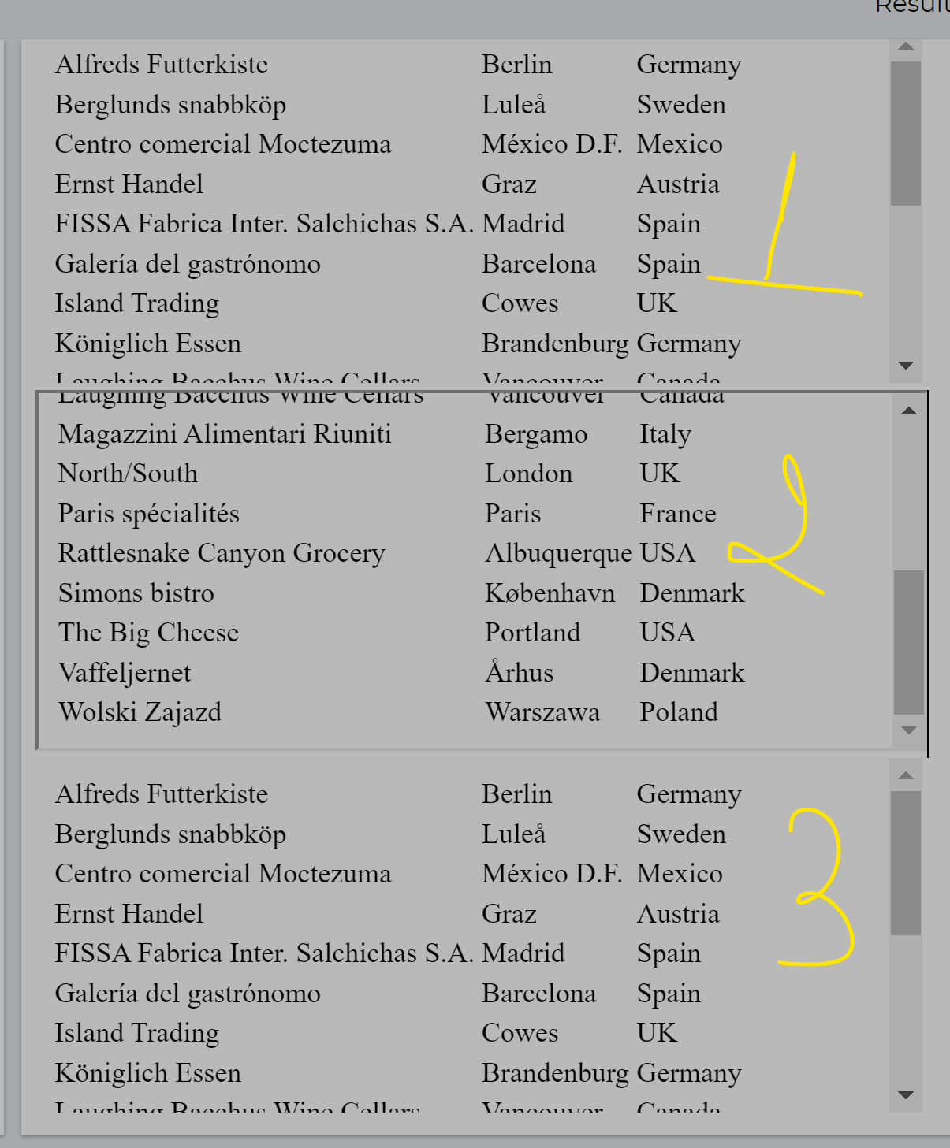
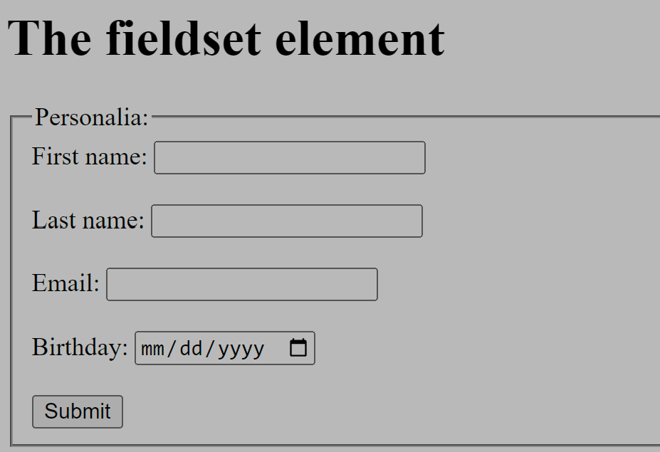
HTML
<embed type="text/html" src="snippet.html" width="500" height="200"></embed>
<iframe src="snippet.html" width="500" height="200"></iframe>
<object type="text/html" data="snippet.html" width="500" height="200"></object>
//3 ways display the page as FRAME.
<form action="/action_page.php">
<fieldset>
<legend>Personalia:</legend>
<label for="fname">First name:</label>
<input type="text" id="fname" name="fname" required><br><br>
<label for="lname">Last name:</label>
<input type="text" id="lname" name="lname"><br><br>
<label for="email">Email:</label>
<input type="email" id="email" name="email"><br><br>
<label for="birthday">Birthday:</label>
<input type="date" id="birthday" name="birthday"><br><br>
<input type="submit" value="Submit">
</fieldset>
</form>

Slide 16
Apply for go to search on fill the form
<input type="text" id="myText" value="A text field">
<button type="button" onclick="getFocus()">Get focus</button>
<button type="button" onclick="loseFocus()">Lose focus</button>
function getFocus() {document.getElementById("myText").focus();} //got to active id.
function loseFocus() {document.getElementById("myText").blur();}
const collection = document.body.children;//all body’s properties
document.getElementById("myP").contentEditable = true;// edit content at myP
const element = document.getElementById("myP").getAttribute("class");//return name class.
<button onclick="myFunction('myList1','myList2')">Compare List 1 and 2</button> //Return false
<button onclick="myFunction('myList1','myList3')">Compare List 1 and 3</button> //Return true
List 1: <ul id="myList1"><li>Water</li><li>Milk</li></ul>
List 2: <ul id="myList2"><li>Coffee</li><li>Tea</li></ul>
List 3: <ul id="myList3"><li>Water</li><li>Fire</li></ul>
<p id="demo"></p>
function myFunction(x,y) {
var item1 = document.getElementById(x).firstChild; //1st property
var item2 = document.getElementById(y).firstChild; //1st property
var x = item1.isEqualNode(item2);
document.getElementById("demo").innerHTML = x;}

Slide 17
Popular Command
array.push(name);=>add the name to the last row of array.
var maxAge = Math.max(...ages); Math.max.apply(null, ages); – Math.min(... ages);
!lotteryNumbs.includes(randomNumb);=>check randomNumb belong to array lotteryNumbs.
Numbs.sort(function(a, b) {return a - b;}); => sort by call function for Numberical value
Numbs.sort()=>sort by Number or String.
var NumbsString = Numbs.join(" ");=> transform from Array to String.
bloodTypes.forEach(function(bloodType) {}); => forEach for array bloodTypes
Object.keys(bloodTypeCounts).forEach(function(bloodType) {});=>get value from bloodTypeCounts[bloodType].count ➔ bloodTypeCounts is Object.=>Viope-Chapter6 09.05
bloodTypeCounts = {"A+": {count: 4, value: 123}, "O-": {count:2, value:323}, "AB+": {count:4,value:434}, "O+": {count:2,value:737}}; forEach(bloodType => {});
***If we define object like {“A+” : {count: {time1: 4, time2: 6}}, “O-”...} => we will call as bloodTypecounts[“A+”].count.time1
let paragraph = document.createElement("p"); // Create a new paragraph element wiht <p>
paragraph.textContent = array[i]; // Set the text content of the paragraph
document.body.appendChild(paragraph); // Append the paragraph to the body of the document

Slide 18
Popular Command
array.push(name);=>add the name to the last row of array. # array.pop(); => delete last.
var maxAge = Math.max(...ages);=> max value of array ages. – Math.min(...ages);
!lotteryNumbs.includes(randomNumb);=>check randomNumb belong to array lotteryNumbs.
Numbs.sort(function(a, b) {return a - b;}); => sort by call function for Numberical value
Numbs.sort()=>sort by Numberical or String.
var NumbsString = Numbs.join(" ");=> transform from Array to String.
bloodTypes.forEach(function(bloodType) {}); => forEach for array bloodTypes
Object.keys(bloodTypeCounts).forEach(function(bloodType) {});=>get value from bloodTypeCounts[bloodType].count ➔ bloodTypeCounts is Object.=>Viope-Chapter6 09.05
bloodTypeCounts = {"A+": {count: 4, value: 123}, "O-": {count:2, value:323}, "AB+": {count:4,value:434}, "O+": {count:2,value:737}};
***If we define object like {“A+” : {count: {time1: 4, time2: 6}}, “O-”...} => we will call as bloodTypecounts[“A+”].count.time1
let paragraph = document.createElement("p"); // Create a new paragraph element wiht <p>
paragraph.textContent = array[i]; // Set the text content of the paragraph
document.body.appendChild(paragraph); // Append the paragraph to the body of the document

Slide 19
Popular Command
array.reverse(); => array.sort() just follow from a->z => so we use reverse for Z-A
if (name.trim() !== ""){names.push(name.trim());}//not empty => remove the spaces=>add last
const image = document.createElement("img");
image.src= "https://upload.wikimedia.org/wikipedia/230px-Snow_flake.svg.png";
document.getElementById("images").appendChild(image);
let currentYear = new Date().getFullYear(); - getMonth() – getDay – getDate…
var firstThreeCharacters = name.substring(0, 3);➔ start from index 0 with 3 steps
dd.MM.yyyy var day = parseInt(dateText.substr(0, 2)); // start from index 0 with 2 steps
var month = parseInt(dateText.substr(3, 2)) - 1; // Jan is 0 so need to minus 1
var year = parseInt(dateText.substr(6, 4));
var dayOfWeek = new Date(year, month, day).getDay(); =>dayOfWeek === 0 is Sunday
var parts = dateText.split("."); parts[0] = dd, parts[1]-1 = MM, parts[2] = yyyy.
let jsonString = '{"name": "John", "age": 30, "city": "New York"}';
let jsonObject = JSON.parse(jsonString);

Slide 20
String
string.at(0) or string.at[0] or string.chartAt(0) -> -1 === (string.length-1)
string.charCodeAt(0) or string.codePointAt(0) => Returns the Unicode value
string.concat(string1, string2, ..., stringX) => join strings together.
string.endsWith(“abc”);=>check condition for ends of string -> return true or false.
string.endsWith(“abc”,length); => abc is end word at the index length, it means abc is not the end word of string,
string.fromCharCode(72, 69, 76, 76, 79); => HELLO, transform from Unicode value to Word.
string.includes(searchvalue, start); => check from index (start) of string. => True or False.
string.indexOf(searchvalue, start);=> return the first match.
string.lastIndexOf(searchvalue, start); => return the last match.
string1.localeCompare(string2);=> string1 come after return -1, before return 1, same = 0
string.match(“abc”); or string.match(/abc/); => return string “abc” if matched.
string.match(/abc/g); => return array abc,abc,abc… depend the times of matched.
string.match(/abc/gi);=> return array abc, Abc, ABC… depend the times of matched.
“01-07-2017”.match(/^\d{2}-\d{2}-d{4}/);=> /^ Start the searchvalue.
/^\d{2}.\d{2}.\d{4}/.test(“31.07.2018”); => return to true.
string.padEnd(length, string); => ex: 5.padEnd(4,”x”) => 5xxx - string.padStart(length, string);

Slide 21
String
string.repeat(count);=> just repeat the string.
string.replace(searchValue, newValue); =>replace the first match.
string.replaceAll(searchValue, newValue);=> replace all match.
string.search(searchValue);=> return index position at first match or -1 (not match)
string.slice(start, end);=>return string without etter at end => slice(-3); 3 last letters.
string.startsWith(searchValue, start)=> search string from “start index”.
string.substr(start, length) or string.substr(start); => take the string from index start.
string.substring(start, end); => take from start to end-1, same with slice
but string.substring(-5); means start from 0. slice(-5) take 5 last letters.
string.toLocaleLowerCase(“language”);->BCP 47 language tags “en/tr/de/es/fr/it/pt/ru/zh/vi/th”
string.toLowerCase();=>don’t care about the language.
string.toString();=> multiple or divide operators, Javascript understand as number.
string.trim(); string.trimEnd(); string.trimStart();=>space between 2 words don’t change.
string.replace(/^\s+|\s+$/gm,‘’); ⬄ string.trim(); if we would like the keep 1 space only between two words, (/\s{2,}/gm,’ ‘)
string.trim().replace (/\s{2,}/gm,’ ‘); => keep 1 space between 2 words.

Slide 22
Array
const array = new Array(10); or Array(10); or array = [];(length = 0)
array.fill(value);=> fill value to all of elements. - array.fill(value,start);
const words = ['spray', 'elite', 'exuberant', 'destruction', 'present’,’spray’];
words.filter((word) => word.length > 6);//return Array ["exuberant", "destruction“,…]
words.find((word) => word.length > 6);//return exuberant (1st element) - words.findLast
words.findIndex((word) => word.length > 6);//return 2 (1st index) – words.findLastIndex
words.flatMap((word) => (word.includes(“eli") ? "Y" : word)); ->return new array new value.
words.Map((word) => (word.includes(“eli") ? "Y" : word)); -> create array of array.
const array = [1, 2, 3];
const mappedArray = array.map(x => [x, x * 2]);
console.log(mappedArray); // [[1, 2], [2, 4], [3, 6]]
const flatMappedArray = array.flatMap(x => [x, x * 2]);
console.log(flatMappedArray); // [1, 2, 2, 4, 3, 6]
console.log(Array.from(‘TMM', (x) => x + 'a'));// Expected output: Array [“Ta", “Ma", “Ma"]
words.lastIndexOf(‘spray’);=>return last index – words.indexOf(‘spray’); =>return 1st index.
words.reverse();=>return the new reversed array.//words.shift(); delete 1st ⬄ words.slice(1);

Slide 23
Array
// Creating an array-like object
const arrayLike = { 0: 'a', 1: 'b', 2: 'c', length: 3 };
// Using Array.from() with a mapping function to concatenate elements with 'a'
const concatenatedArray = Array.from(arrayLike, element => element + 'a');
console.log(concatenatedArray); // Output: ['aa', 'ba', 'ca’]
let arr = [1, 30, 4, 21, 100000];arr.sort((a,b) => a-b);//sort by value, default string.
arr.some(element => {return element > 21});//return true. – arr.some(element => element>21);

Slide 24
Loop
const arrays = [ 11 , 22, 33];
for (const key of arrays.keys()) {
console.log(`Index ${key} at Value ${arrays[key]}`);}
for (const [index, array] of arrays.entries()) {
console.log(`Index: ${index}, Element: ${array}`);
for (let i=0;i<arrays.length;i++){
console.log(`Index ${i} at Value ${arrays[i]}`);}
arrays.forEach(function(array,index) { //can use any words: element, position….
console.log(`Index ${index} at Value ${array}`);});
arrays.forEach((array,index) => { //2nd way.
console.log(`Index ${index} at Value ${array}`);});
for (const element of arrays) {
console.log(`Element: ${element}`);}
arrays.forEach(element => {
console.log(`Element: ${element}`);});

Slide 25
Java Script with HTML
Get DATA from HTML
Output to HTML
var element = document.getElementById"myElement“;
var valueele = element.value;
valueele = parseFloat(valueele);//parseInt
var elements = document.getElementsByClassName(“myClass”);
var element = document.querySelector("#myElement");//1st
var elements = document.querySelectorAll(".myClass");
)
var pOutput = document.getElementById("pOutput");
pOutput.innerHTML = "Your email: " + txtGivenName + "." + txtSurname + "@myy.haaga-helia.fi";
window.addEventListener("click", function(){
document.getElementById("demo").innerHTML = "Hello World!";});
element.style.color = "red"; => change to style of element.
<button onclick="myFunction()">Open Window</button>
function myFunction() {const myWin = window.open("", "", "left=100, top=350, width=500, height=900");}

Slide 26
function listCoursesUsingAppendChild() {
let answerDiv = document.getElementById("answer");
answerDiv.innerHTML = ""; // Clear previous content
courses.forEach(function(course) {
let courseInfo = document.createElement("p");
courseInfo.innerHTML = `
Code:</strong> ${course.code}<br>
Name:</strong> ${course.name}<br>
Extent:</strong> ${course.extent}<br>
Timing:</strong> ${course.timing} `;
answerDiv.appendChild(courseInfo); });}
function listCoursesUsingInnerHTML() {
let answerDiv = document.getElementById("answer");
answerDiv.innerHTML = ""; // Clear previous content
let coursesHTML = "";
courses.forEach(course => {
coursesHTML += `
<p>
Code:</strong> ${course.code}<br>
Name:</strong> ${course.name}<br>
Extent:</strong> ${course.extent}<br>
Timing:</strong> ${course.timing}
</p>
`;});
answerDiv.innerHTML = coursesHTML;}
Add the new line at ID ”answer” not overwrite.
createElement: create 1 paragraph <p>
createTextNote: create the sentences only.
Output at ID ”answer” 1 time, because it overwrite

Slide 27
constructor function
// Define the Country constructor function
function Country (countryName, countryPop, countryFinnish) {
this.name = countryName;
this.population = countryPop;
this.finnish = countryFinnish; }
// Create instances for each country
var finland = new Country("Finland", 5501043, "Suomi");
var sweden = new Country("Sweden", 10367232, "Sverige");
var norway = new Country("Norway", 5367580, "Norge");
var denmark = new Country("Denmark", 5818553, "Danmark");)
=> sweden.name -> Sweden / Sweden.population -> 10367232.
let str = "Mr Blue has a blue house, blue hat, blue shoes, blue car, blue sky, blue ocean, and blue eyes.";
let replacedCount = 0;
let res = str.replace(/\bblue\b/g, function(match) {
replacedCount++;
if (replacedCount === 1 || replacedCount === 4 || replacedCount === 7) {
return "red"; }
else { return match; } });
console.log(res);
Mr Blue has a red house, blue hat, blue shoes, red car, blue sky, blue ocean, and red eyes.

Slide 28
constructor function
function Person(first, last, age, eyecolor) { this.firstName = first; this.lastName = last; this.eyeColor = eyecolor; } //add new properties to objects (constructor func) Person.prototype.nationality = "English";
let str = "Mr Blue has a blue house, blue hat, blue shoes, blue car, blue sky, blue ocean, and blue eyes.";
let replacedCount = 0;
let res = str.replace(/\bblue\b/g, function(match) {
replacedCount++;
if (replacedCount === 1 || replacedCount === 4 || replacedCount === 7) {
return "red"; }
else { return match; } });
console.log(res);
Mr Blue has a red house, blue hat, blue shoes, red car, blue sky, blue ocean, and red eyes.

Slide 29
Object (function into)
let person = {
firstName: "John",
lastName: "Doe",
age: 30,
howtodo: function() {
return `
${this.firstName} ${this.lastName} with age ${this.age}
`; } };
let result = person.howtodo();
console.log(result); // Output: John Doe with age 30
let str = "Mr Blue has a blue house, blue hat, blue shoes, blue car, blue sky, blue ocean, and blue eyes.";
let replacedCount = 0;
let res = str.replace(/\bblue\b/g, function(match) {
replacedCount++;
if (replacedCount === 1 || replacedCount === 4 || replacedCount === 7) {
return "red"; }
else { return match; } });
console.log(res);
Mr Blue has a red house, blue hat, blue shoes, red car, blue sky, blue ocean, and red eyes.

Slide 30
Thank you! Enjoying Coding like Playing Game!

